Slide 1
Central Administration Survey: Impact Summary
Prepared by: Maggie Fiacchi

Slide 2



Overview
What is the
Central Administration (CA)
Survey?
What did we learn from the 2021 CA Survey?
What did we do?
Notes:
Today's presentation will begin with an introduction to the CA Survey (or a reintroduction for some of you), then I will briefly talk about what was learned from the 2021 CA Survey, leading into the main component of this presentation – what did CA do as a result of what we learned.

Slide 3
BPS 4: Offer Services Intensely
What is the CA Survey?

Slide 4
Central Administration (CA) Survey
A comprehensive survey of Central Administration function and
activities.
In 2021, the CA Survey was administered system wide to all Healthy Families NY program managers.
Survey produced 93% response rate.
Notes:
While PMs where the ones completing the survey, Central Administration created a discussion tool and encouraged Program Managers to use it in order to gather insight from across levels of staff at their program so that their responses could represent a program perspective, not just a program manager perspective.
Forty programs responded to the survey, which equates to a 93 percent response rate.

Slide 5
Policy
HFNY
Multi-Site
System
Administration
Training
Racial
Equity
Cultural Humility
Evaluation
Quality Assurance
Technical Assistance
Notes:
The survey addressed each of the six functional areas of CA responsibility, as well as CA's ability to perform their work to reflect racial equity and cultural humility.
Each survey module asked programs to respond to 10 items using a five-point rating scale ranging from strongly disagree (1) to strongly agree (5) and three open ended questions, which asked program managers to elaborate on how CA activities in each of the areas have helped their program, hindered them, and what further supports were needed.

Slide 6
BPS 4: Offer Services Intensely
What did we learn ?

Slide 7
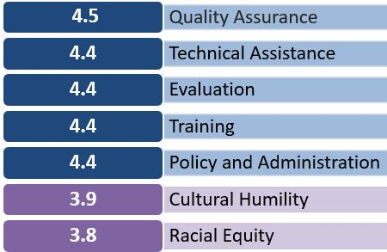
Overall
Satisfaction
4.3​
1 = Strongly Disagree
2 = Disagree
4 = Agree
5= Strongly Agree
3 = Neither Agree or Disagree
Notes:
Programs responses for each of the 10 module items were averaged to generate a mean score, the average of these scores across all 40 program respondents generated overall scores for each of the seven modules. For the modules pertaining to the six functional areas, CA was rated at either a 4.4 or 4.5 out of 5, suggesting high levels of support / satisfaction with CA activities. The modules focused on racial equity and cultural humility showed greater room for improvement, producing overall scores of 3.8 and 3.9 respectively. The individual module scores were then used to derive an overall satisfaction score which rated system satisfaction with CA function at a 4.3 out of 5.
From the results CA was able to gain insight into the various aspects of practice where they were especially effective and where there is room for improvement and growth. Throughout the survey several programs shared in their open-ended responses that they feel supported by CA and that they appreciate all the effort CA puts into helping programs to function. CA rated the highest on items throughout the survey related to respectful interactions with program staff and the belief by programs that CA members are qualified and knowledgeable. The survey results called specific attention to CA’s need to improve in their ability to demonstrate racial equity and cultural humility in their work.

Slide 8
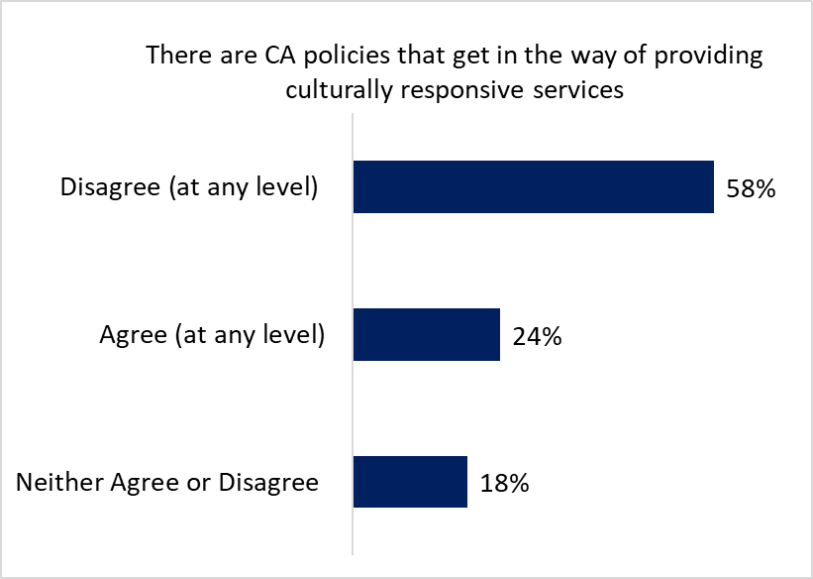
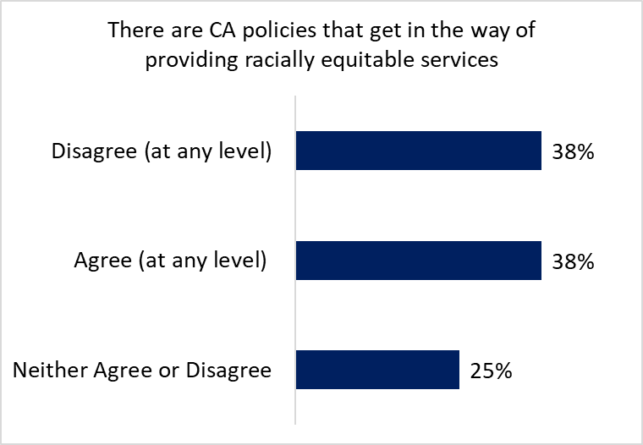
Notes:
One of the most significant findings from the survey was that 24 percent of programs agreed that there are CA policies which get in the way of providing culturally responsive services, and that 38 percent of programs responding to the survey agreed that there are CA policies that get in the way of providing racially equitable services.

Slide 9
BPS 4: Offer Services Intensely
What did we do?
Notes:
So what did we do with what we learned ?
The CA Survey provided insight into areas for growth in CA function, and it also provided some specific action items, stemming from what was shared in the open-ended portion of the survey where we could make changes within our system to better support program needs.
These activities were undertaken both by Central Administration as a collective group and by the individual partners at OCFS, CHSR and PCANY.

Slide 10
Central Administration Activities
Planning for Accreditation support and materials
Creating unstructured space for Program Managers to interact with each other
Updating Performance Indicators and Targets
Creating statewide marketing materials
Prioritizing Program Recommendations
Notes:
Planning for Accreditation support and materials
Accreditation 101
Self-Study tool
Accreditation Office hours
Self-study reviews
Creating unstructured space for Program Managers to interact with each other
Coffee Breaks during regional meetings and SLM
Aspects of TODAY'S agenda which provide time for you all to build relationships and connections with one another!
Updating Performance Indicators and Targets
Making changes to PIs and PTs not just to meet new BPS standards but with programs in mind AND with consideration of how our chosen PTs reflect considerations for racial equity and cultural humility
Creating statewide marketing materials
Releasing the targeted referral partner pamphlets
CA continued efforts to fund and make available digital outreach cards for all programs in the system
Prioritizing Program Recommendations
Using the EasyRetro Activity to get program manager perspective to help CA prioritize they activities and take into account when addressing ASKS that came out of the CA Survey

Slide 11
CHSR Activities
Creating MIS user webinars
MIS Blog
Developing MIECHV specific reports for certain benchmarks
Matching MIS to Paper Forms
Notes:
Creating MIS user webinars
CHSR has come out with MANY user webinars to help support changes to the MIS system and to foster skill maintenance around proper data entry and use of specific reports
MIS Blog
MISsives were retired and the MIS Blog was created – allowing for better usability!
Developing MIECHV specific reports for certain benchmarks
CHSR is currently working on several new reports specific to MIECHV benchmarks to better support our programs that operate with MIECHV funding
Matching MIS to Paper Forms
After reviewing paper forms used by programs the MIS was updated to reflect consistent language and categories and users gained to ability to print out blank forms directly from the MIS.

Slide 12
CHSR Activities (cont’d)
Creating data documentation for all MIS reports
Updating ethnic and racial categories
Updating MIS options for participant Language
Creation of PI Dashboards
Notes:
Creating data documentation for all MIS reports
Even before the CA survey was administered CHSR had begun to include data documentation on all new reports in the MIS. CA Survey findings supported CHSR's allocation of additional resources to create this documentation for all existing MIS reports, these efforts are ongoing.
Updating ethnic and racial categories
With participation from programs, CHSR was able to identify and update the MIS so that all racial and ethnic groups represented within program's service populations were included on all data collection forms.
Updating MIS options for participant Language
Guided by programs, CHSR also updated options to identify participant primary language to match the most common languages spoken by families at sites.
Creation of PI Dashboards
CHSR developed and launched the PI Dashboards through Tableau to facilitate programs ability to track their PI performance over time.

Slide 13
OCFS Activities
Revision of ASR Feedback Tool
Updating the QA Site Visit Tool
Funding GGK Training for full system
Notes:
Revision of ASR Feedback Tool
OCFS contract management team has begun the process of updating their ASR review tool to enhance the feedback that is provided to programs on their reports. This has included the formation of a workgroup with Program Manager representation in order to include their perspective on the ASR guidelines and feedback tool.
Updating the QA Site Visit Tool
Based on feedback in the CA Survey, OCFS also undertook the process of updating the Site Visit tool to improve quality of QA practice with sites.
Funding GGK Training for full system
The CA survey identified barriers to accessing primary curricula, in response OCFS was able to secure funding to contract with Growing Great Kids Inc, to offer all HFNY program staff the opportunity to be trained to use GKK: prenatal-36 months, 3-5 years, and in RISE curricula. This contract currently stands through 2025.

Slide 14
OCFS Activities (cont’d)
Reconvening of REaCH Committee
Advocating to increase funding to support rising costs
Raising cost per family, to support CWP implementation
Notes:
Reconvening of REaCH Committee
the OCFS branch of CA reconvened the Racial Equity and Cultural Humility committee, a workgroup focused specifically on these topics and how we can improve practice to better reflect these perspectives at all levels of the HFNY system. Central Administration has relied on this group’s insight for policy language, updating performance indicators and performance targets, assisting with updating the ASR tool, and more.
Advocating to increase funding to support rising costs
Another major theme conveyed in CA Survey responses was the need to increase salaries at programs. This echoed feedback CA has heard repeatedly related to the need to increase compensation to address issues of staff turnover, burnout, and difficulties filling vacancies. In response to this feedback OCFS partners advocated for funding increases to support the rising cost to deliver services, amended contracts to allow for staff bonuses (which were historically not allowed) and strongly encouraged and guided administration at agencies to use the increase to support staff salaries through a bonus or salary increase.
Raising cost per family, to support CWP implementation
Another effort OCFS undertook to address budgetary needs was advocating for raising the cost per family to support implementation of the Child Welfare Protocol (CWP). Implementation of the CWP requires additional resources at the program level to make sure that program staff have adequate training, reflective consultation, supervision, and materials to work with families receiving child welfare services. OCFS was able to include increased cost per family rates in newly funded and expanded contracts implementing the CWP. As additional funds become available, OCFS will incorporate the CWP and corresponding increased cost per family into existing sites.

Slide 15
PCANY Activities
Service Plan Handbook
Family Support Specialist refresher trainings
Supervisor and FSS professional development forums
Updating prenatal training language
Notes:
Service Plan support tools
PCANY has created a comprehensive Service Plan Handbook that can be access from the Transfer of learning tools – this need for first identified from the CA Survey
Family Support Specialist refresher trainings
In response for calls for training to support more veteran staff PCANY arranged for FSS refresher trainings which have been offered to those hired prior to 2015 and then prior to 2020.
Supervisor and FSS professional development forums
In response to this feedback provided in the CA Survey, PCANY has begun to offer regular Supervisor and FSS professional development forums. These create an opportunity for program staff to receive additional support around specific areas of practice and to interact with others working in their role throughout the state.
Updating prenatal training language
The PCANY team updated the language as much as possible in the current training and included a message in the beginning of the training conveying the goal of inclusivity to all parents’ prenatal experiences.

Slide 16
PCANY Activities (cont’d)
Hiring bilingual FRS QA Specialist
Increasing language accessibility for training materials
Centralizing training materials
Notes:
Hiring bilingual FRS QA Specialist
Since the CA Survey, PCANY has hired a FRS Specialist that can provide QA and TA in Spanish / with staff who perform their duties in Spanish
Increasing language accessibility for training materials
Recent updates to the CHEERS Handbook included providing CHEERS for Parents materials in nine different languages.
Centralizing training materials
Since the 2021 CA Survey was administered PCANY has shifted almost all their training materials and practice support tools to the Transfer of Learning and Training (TOL&T) website. PCANY is considering how to centralize and streamline the registration process for all trainings they offer.

Slide 17
BPS 4: Offer Services Intensely
What’s next?
Notes:
So what’s next?

Slide 18
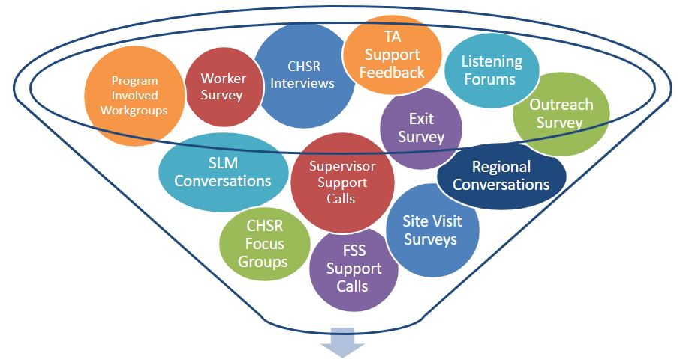


System Analysis
We already collect so much information from you, let's use it!
Analyze Information
Synthesize Information
Targeted Conversations
Notes:
Reviewing all of the notes and documentation we have from things like: SLMs, Regionals, QA Surveys, Site Visits, Listening Forums, Supervisor/FSS/FRS Support Calls, Worker Survey, Exit Survey, CHSR Focus Groups / Interviews, Committees with program members, TA feedback.
Synthesizing all of the information we have in order to identify strengths and areas for growth for how CA can better support our system, identifying areas where we might need or want a little more information from PMs, supervisors or staff within the system .
Coming back together as a system to share what we learned and to

Slide 19
BPS 4: Offer Services Intensely
Thank you!
Notes:
So what’s next?

